Slide 1
Passenger and Freight Railroad Employee Data
By Dora Cheng, Andrea Curo, Sonam Shah

Slide 2
The Data - Description
Survey of freight and railroad employees
Position, age, sex of employees
Caffeine Factors
Intake Amount
Sleep Factors
Work Schedule
Activity Log

Slide 3
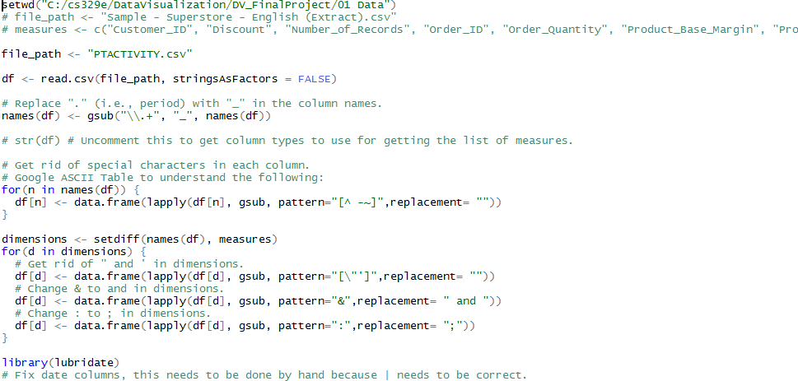
The Data - Processing
Separate
Reformat

Slide 4
Overview of the Data
Sleep Quality
1 (very poor) – 5 (very good)
Falling Asleep
5 (very easy) – 1 (very difficult)
Health Status
4 (excellent) – 1 (poor)

Slide 5
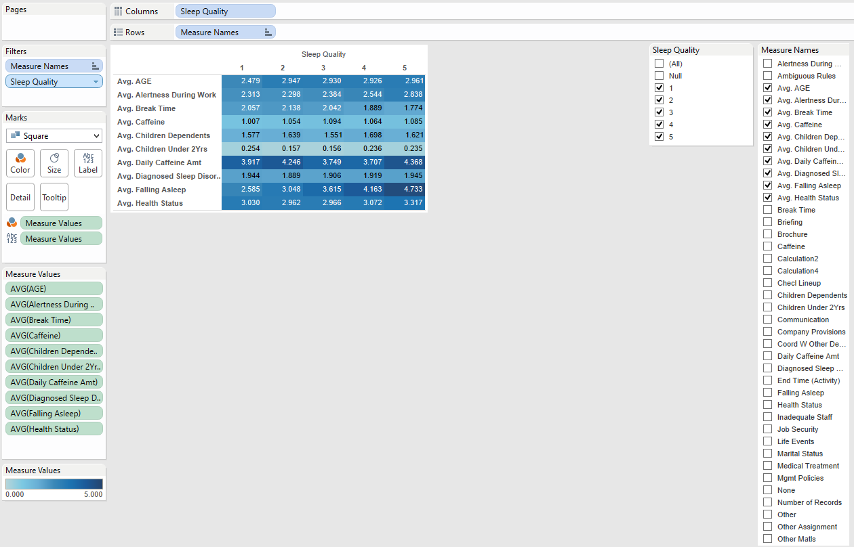
Measure vs Sleep Quality

Slide 6
Measure vs Sleep Quality

Slide 7
Measure vs Sleep Quality

Slide 8
Measure vs Sleep Quality

Slide 9
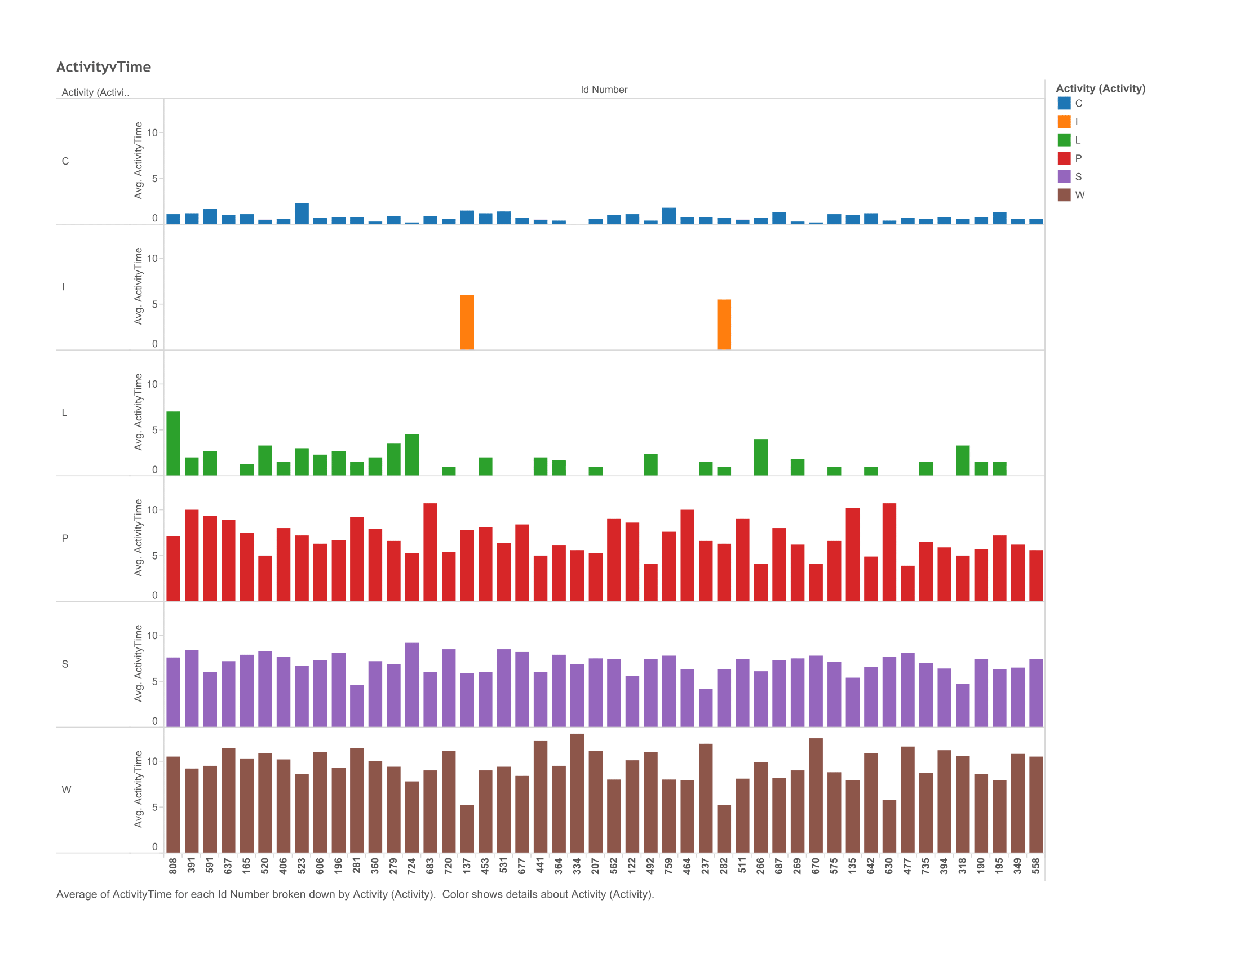
Time per Activity Type

Slide 10
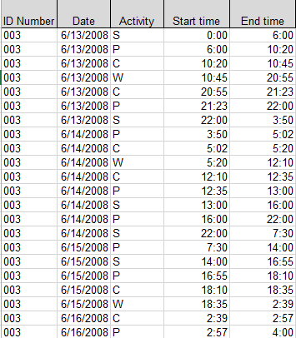
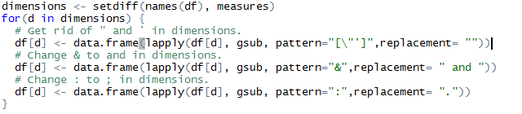
Time per Activity Type
Reformatting Data

Slide 11
Time per Activity Type
Created calculated field
IF [Start Time (Activity)]>[End Time (Activity)]
THEN 24 - [Start Time (Activity)] + [End Time (Activity)]
ELSE [End Time (Activity)] - [Start Time (Activity)] END

Slide 12
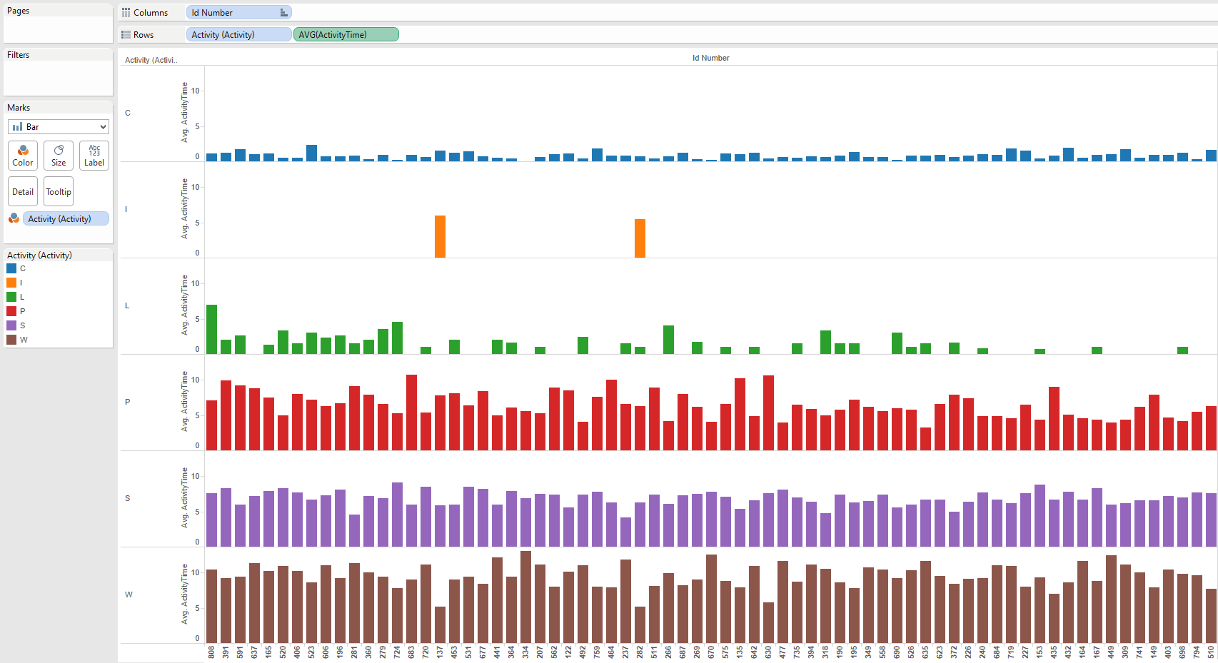
Time per Activity Type

Slide 13
Time per Activity Type

Slide 14
Time per Activity Type

Slide 15
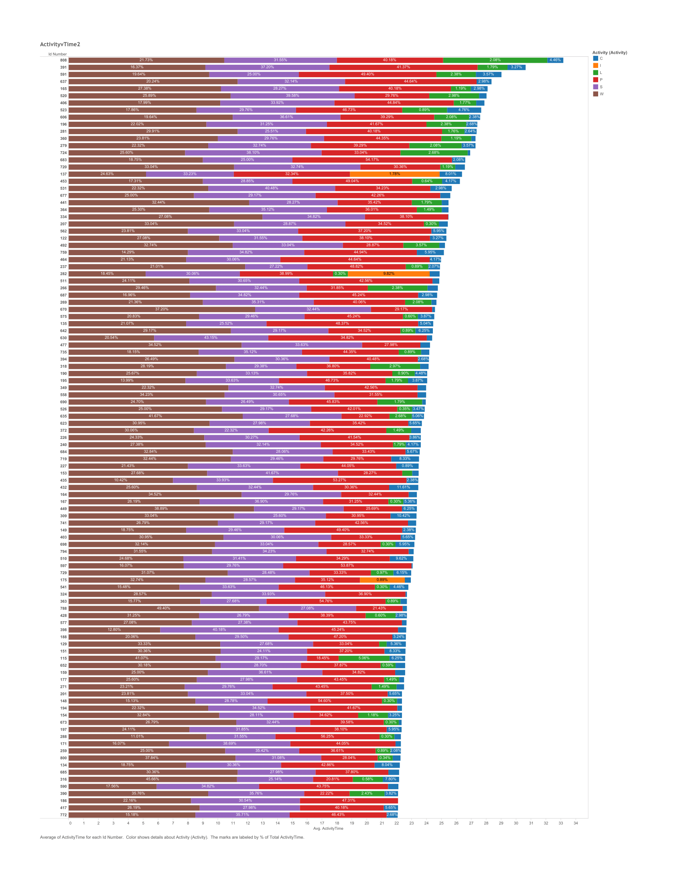
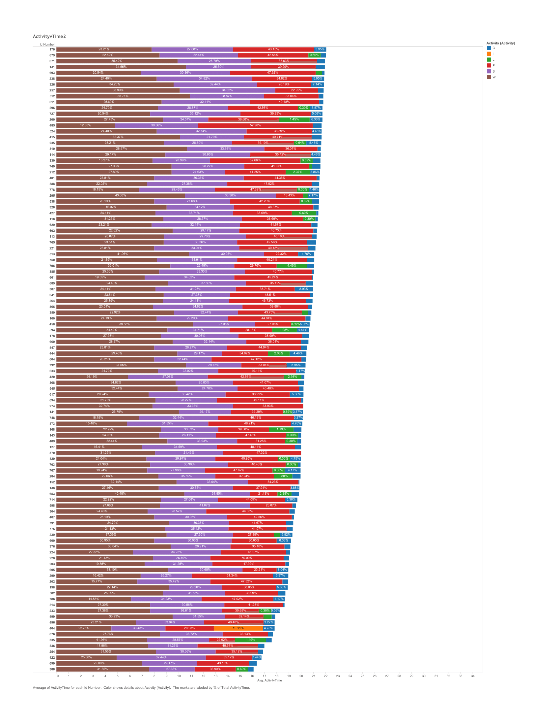
Time per Activity Type v2

Slide 16
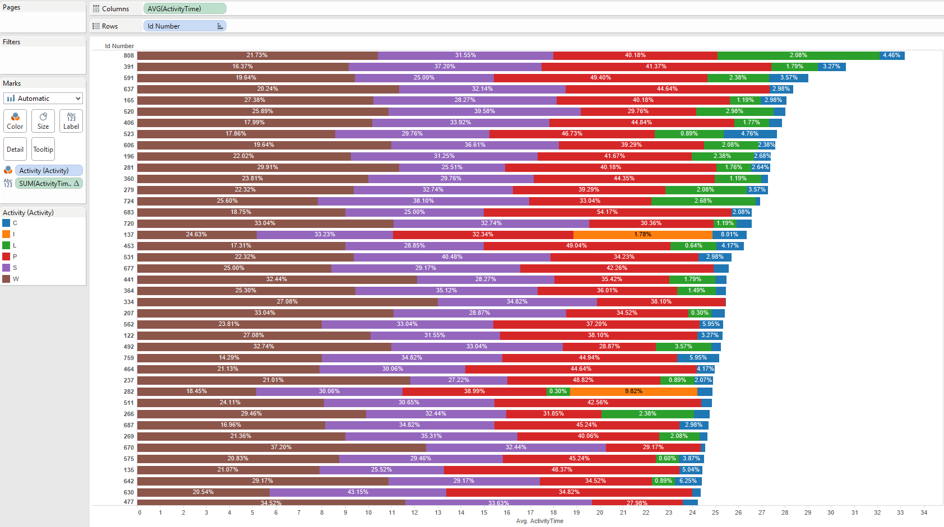
Time per Activity Type v2

Slide 17
Time per Activity Type v2

Slide 18
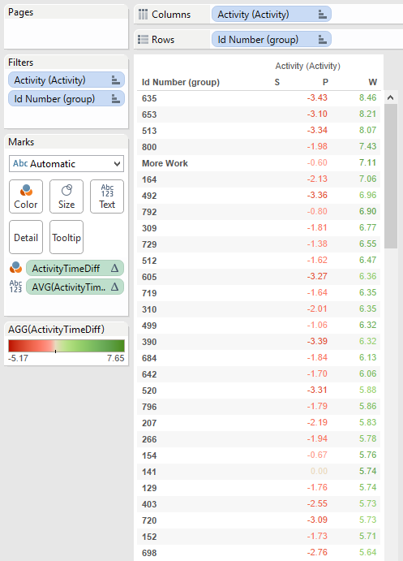
Group by Activity
Filtered by most time consuming activities
Calculated difference from activity S (sleep)
ZN(AVG([ActivityTime (copy)])) - LOOKUP(ZN(AVG([ActivityTime (copy)])), -1)
Purpose was to group

Slide 19
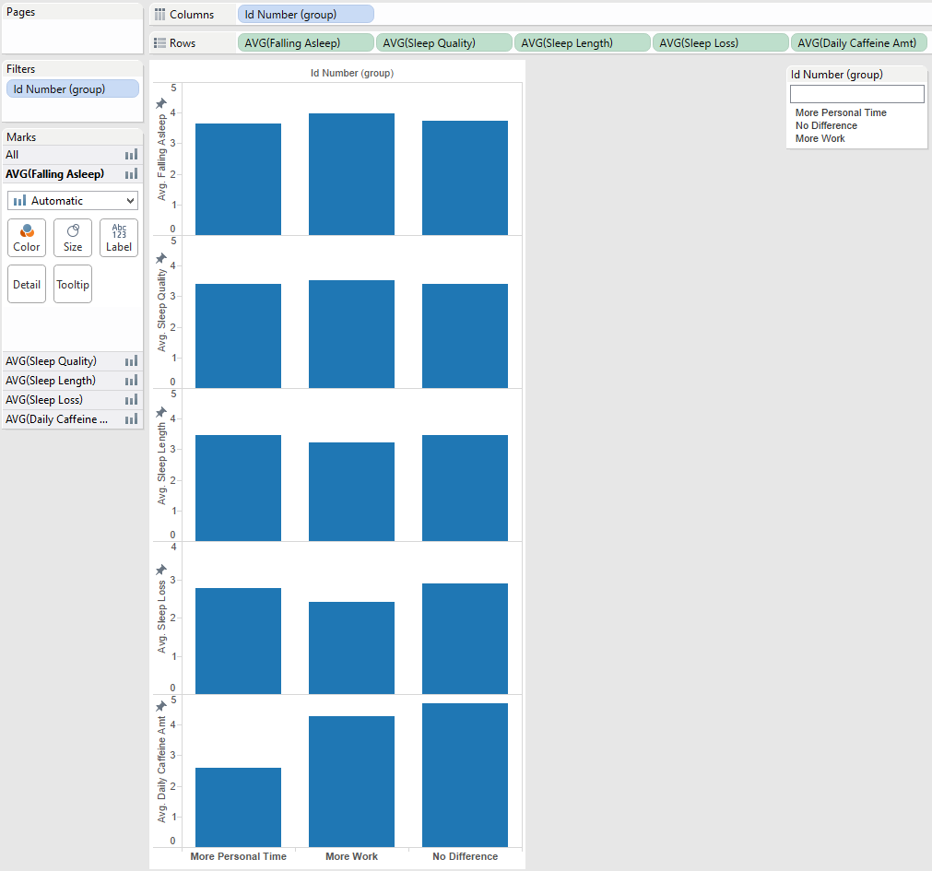
Group Analysis

Slide 20
Group Analysis

Slide 21
Group Analysis

Slide 22
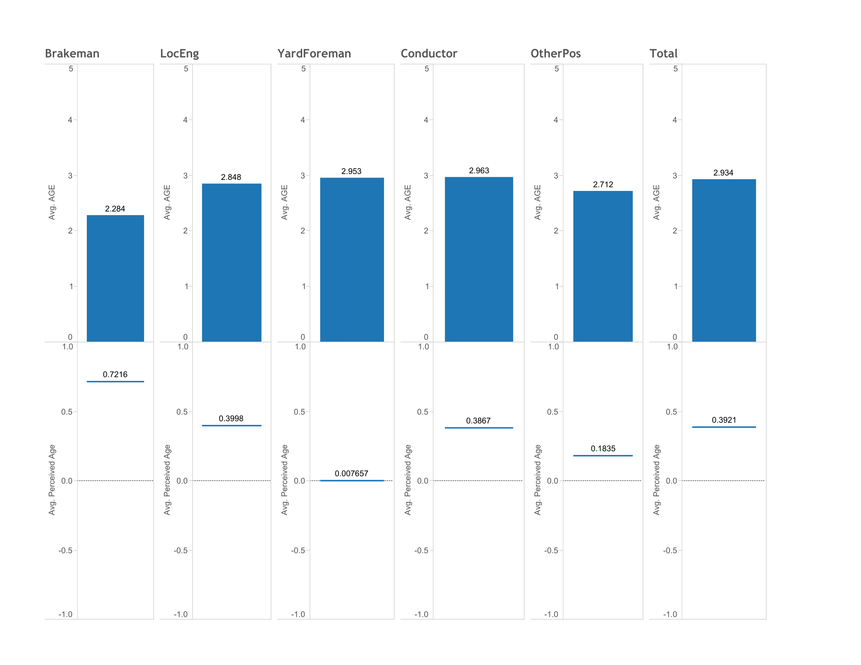
Job and Age Status
Jobs titles as dimensions
Separate worksheets
Utilized dashboard

